Slide 1

Course Title | Web Application Design
Course Faculty | S. M. Zafrul Islam Most. Thasin Sabira
Presentation for | Lab Project (Progress Update)
Project Title | “Academic Scheduler”
Student Name | Gaus Saraf Murady
Student Roll | 0432410005101088

Slide 2
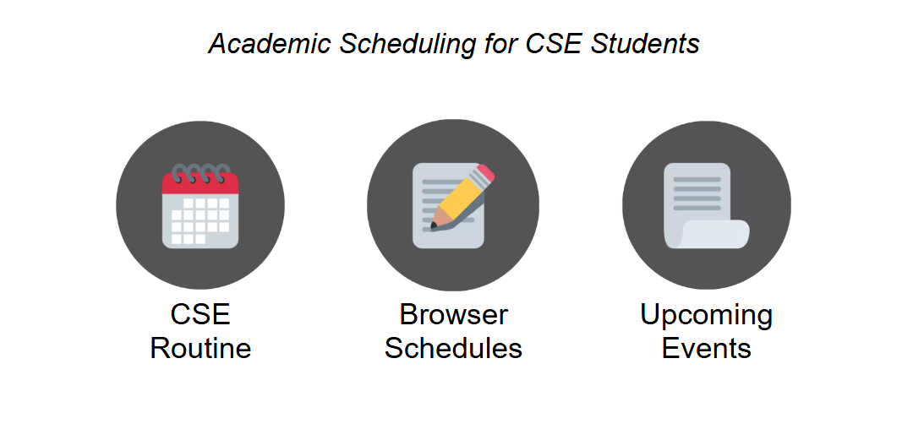
My Project is about keeping schedules and managing tasks for Students.
Features:
CSE Class Routine
Semester-wise Schedule
Events Planner

Slide 3
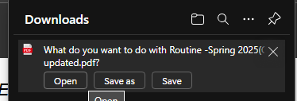
This button will download the
CSE class routine of UITS

Slide 4
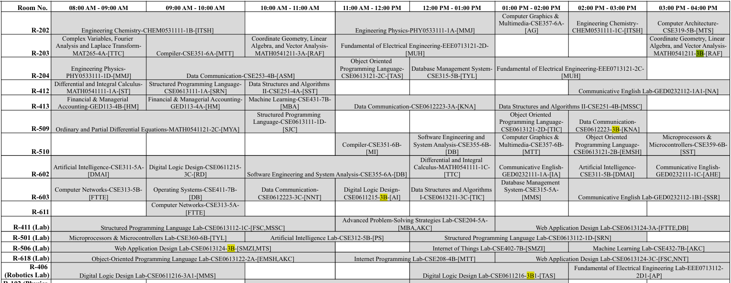
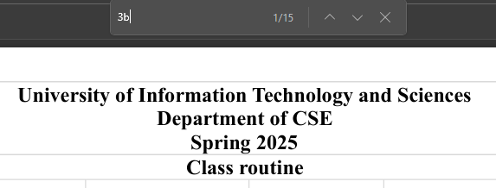
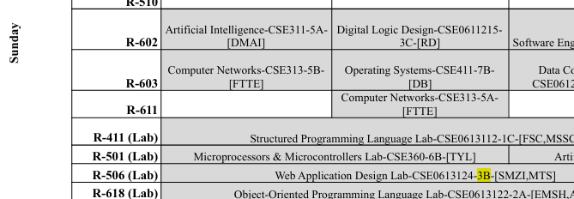
Searching by section (3B) will filter specific routine for them

Slide 5
This button redirects to a semester list, and afterwards shows course lists and schedules for each semester

Slide 6
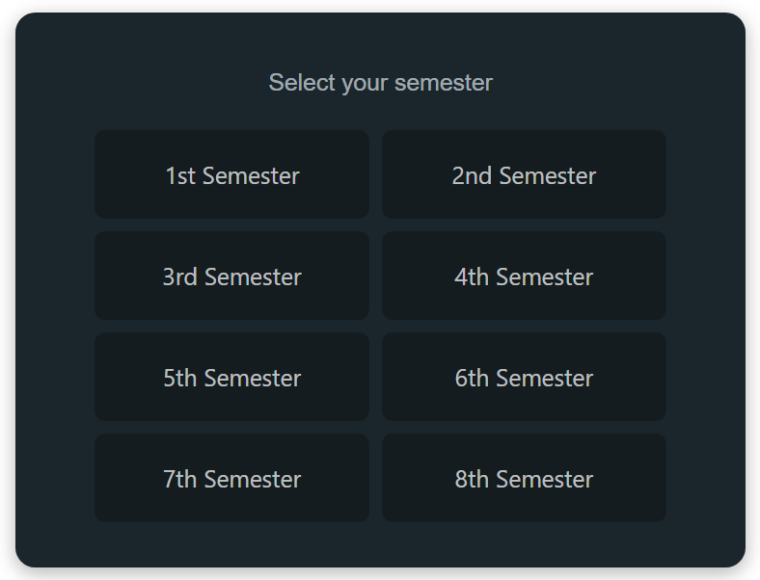
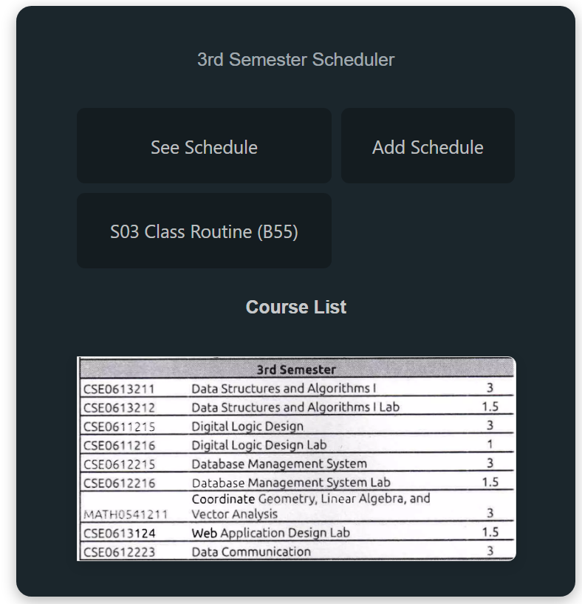
Click here to
add schedules
Click here to
see schedules

Slide 7
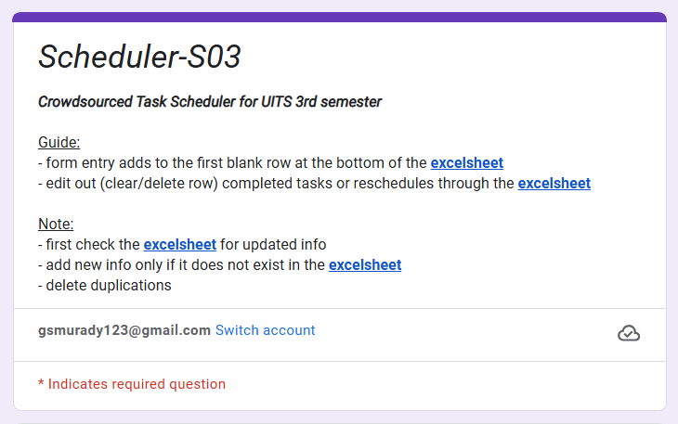
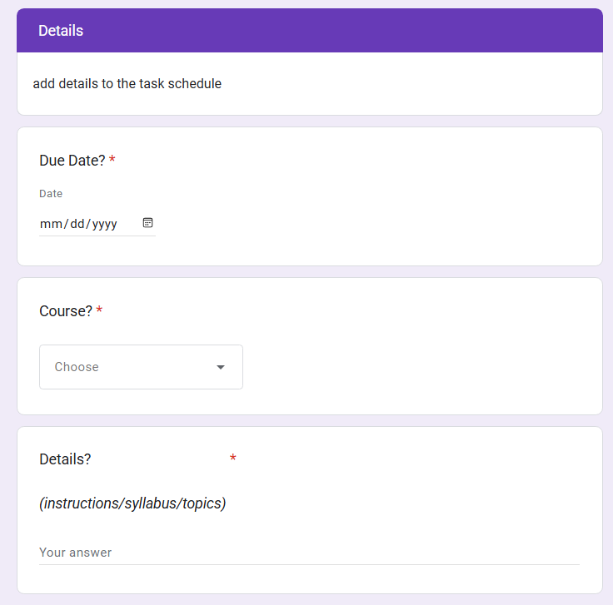
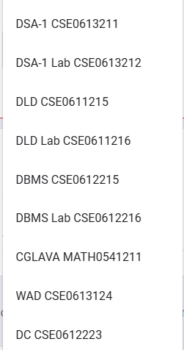
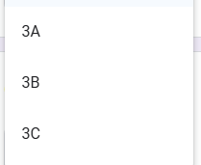
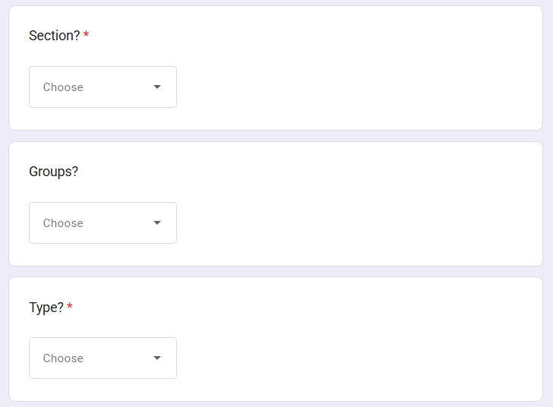
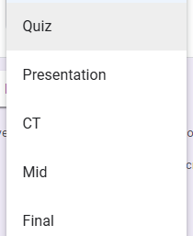
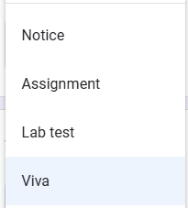
Filling out this form will add the schedule to a Google Sheets

Slide 8
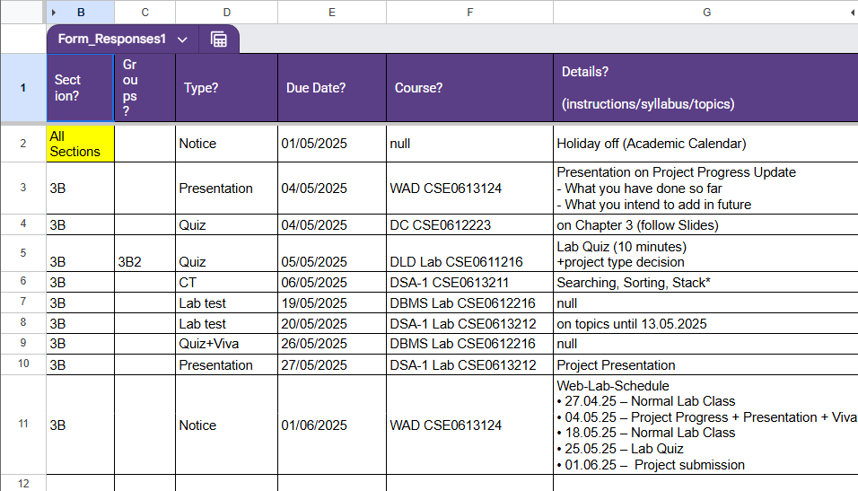
Added schedules
The schedule for WAD Project Presentation is right there

Slide 9
This button redirects to a list where upcoming events are listed

Slide 10
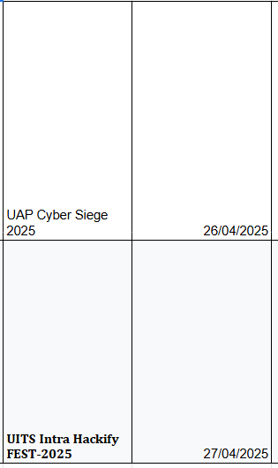
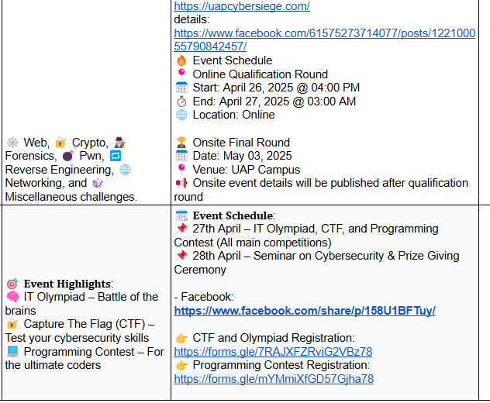
Events List

Slide 11
Features I want to add in future :
Checklists for personal tasks
Note taking
Pinned notes
(This features require a good level of skill in JavaScript, compared to the current features that was done using HTML+CSS)

Slide 12
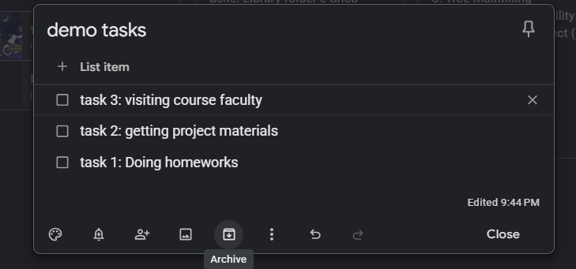
checklists

Slide 13
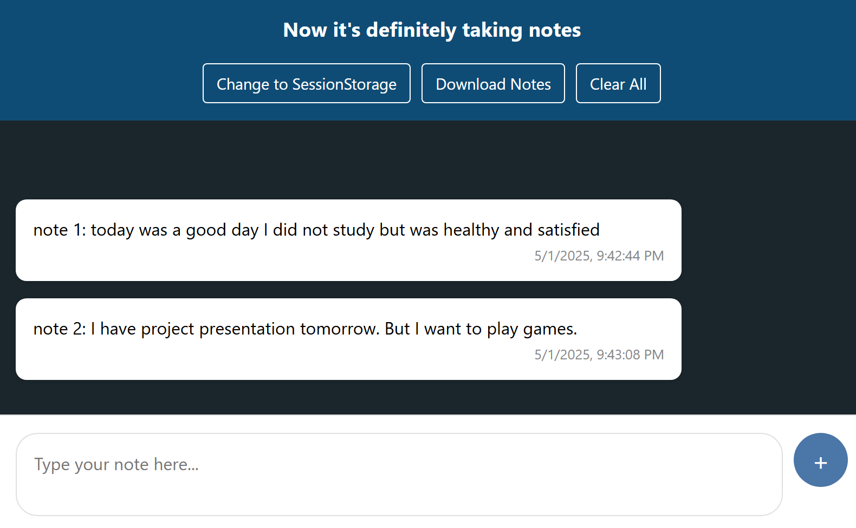
Note taking

Slide 14
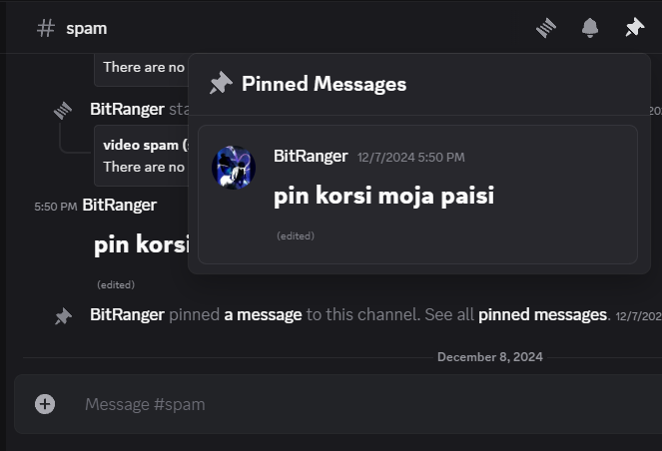
Pinned notes

Slide 15
Thank you for your time!
(Feel free to ask questions and clear any confusions)

